Slide 1
Cardiovascular Disease Prediction using GAN and CNN

Slide 2
Cardiovascular Disease Prediction using GAN and CNN
PREV
NEXT
Presented by
Batch no:4
A.Sai Kiran 21NG1A6101
P.Spandana 21NG1A6143
M.Vikas 21NG1A6130
V.Gopi 21NG1A6152
Under the Esteemed Guidance of
Dr K P N V SATYA SREE
USHA RAMA COLLEGE OF ENGINEERING AND TECHNOLOGY
DEPARTMENT OF ARTIFICIAL INTELLIGENCE AND MACHINE LEARNING

Slide 3
TABLE OF CONTENTS
6
7
7
PREV
NEXT
1
2
3
4
5
Abstract
Literature Survey
Motivation
Problem Statement
Feasibility Study
10
8
9
Dataset Used
Implementation
Conclusion
Future Work
References
URCET-AIML
3

Slide 4
Abstract
PREV
NEXT
This project explores an efficient method for cardiovascular disease (CVD) prediction using Generative Adversarial Networks (GAN) and Convolutional Neural Networks (CNN).
GAN is used to generate synthetic medical images to overcome data limitations, while CNN is employed to analyze these images and structured health data for accurate prediction.
This hybrid model shows potential in improving early diagnosis and intervention, enhancing performance compared to traditional prediction models.
URCET-AIML
4

Slide 5

Literature Survey
Algorithm | Observation | Paper | Comparison
Logistic Regression | Simple, interpretable, less accurate for complex data | Wang et al. (2019) | Easy to use Limited for non-linear data
Decision Trees | Hierarchical decision-making, prone to overfitting | Chen et al. (2020) | Intuitive structure Can be unstable
CNNs | Effective in image classification and pattern detection | Zhang et al. (2021) | Excellent for spatial data Needs large datasets
Random Forests | Ensemble of decision trees, robust to overfitting | Liu et al. (2018) | Handles various data types Less interpretable than single trees
URCET-AIML
5

Slide 6
PREV
NEXT
Motivation
Cardiovascular diseases are the leading cause of mortality worldwide, with millions of people affected every year. Early and accurate diagnosis is crucial to reduce the impact of CVD.
Traditional methods often lack sufficient accuracy due to limited data and poor generalization.
By leveraging GAN for data augmentation and CNN for image analysis, this project aims to improve prediction outcomes, allowing for more reliable CVD detection.
URCET-AIML
6

Slide 7
Problem Statement
PREV
NEXT
Why this problem was selected:
Cardiovascular diseases are a leading cause of death globally.
Early detection can significantly improve patient outcomes.
Current prediction models have limitations in accuracy and data requirements.
Benefits and advantages over existing systems:
Overcomes data limitations through synthetic image generation.
Improves prediction accuracy by combining image and structured data analysis.
Enhances early diagnosis capabilities, potentially saving lives.
Provides a more robust and adaptable model for various healthcare settings.
URCET-AIML
7

Slide 8
PREV
NEXT
Feasibility Study
Technical Feasibility
Availability of GAN and CNN architectures.
Access to necessary computational resources.
Potential for integration with existing healthcare systems.
Operational Feasibility
Simple interface with features like image upload, GAN/CNN visualization, and prediction results.
Includes error messages for invalid image uploads to enhance user experience.
Regular updates to models using new datasets and periodic performance testing.
8
URCET-AIML

Slide 9
Dataset Used
Source:
The dataset is taken from Kaggle, containing MRI images of the heart used for cardiovascular disease prediction.
Type of Data:
MRI images of the heart used for cardiovascular disease prediction. Images are in a pixel format, representing various cardiac conditions.
Labels:
Normal: Healthy cardiac tissue.
Sick: Cardiovascular disease (e.g., coronary artery disease, heart failure).
Data Augmentation:
Synthetic images generated using GANs to enhance the dataset and improve model robustness.
URCET-AIML
9

Slide 10
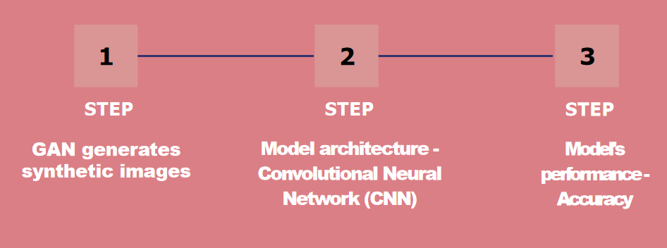
Implementation
URCET-AIML
10

Slide 11
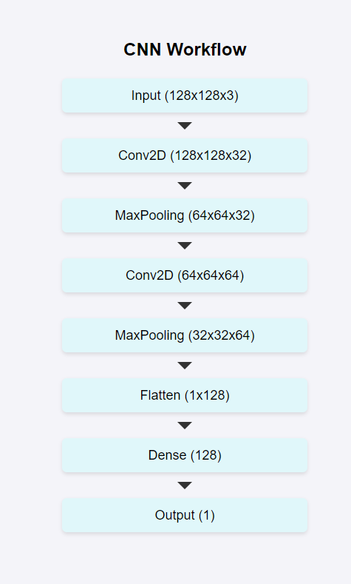
Model Architecture
URCET-AIML
11

Slide 12
Model Performance
Our CNN model’s overall accuracy on the test set is 98.85%.
Accuracy on the training set - 98.88%
URCET-AIML
12

Slide 13
Conclusion
The GAN-CNN model demonstrated exceptional performance in predicting cardiovascular diseases.
Achieved a training accuracy of 99.88% and a testing accuracy of 98.85%.
Leveraged GAN-generated synthetic images to enhance model accuracy and reliability.
Provides an efficient and automated system for accurate disease predictions, supporting healthcare professionals in decision-making.
URCET-AIML
14

Slide 14
Future Work
Model Improvements:
Enhance GAN and CNN architectures for better accuracy and faster processing.
Integrate additional data types like CT scans and X-rays for broader detection.
Multi-Disease Detection:
Expand system capabilities to detect neurological disorders or pulmonary diseases.
Develop multi-disease classification models for a more comprehensive tool.
Real-Time Integration:
Implement real-time integration with hospital information systems (HIS) for seamless diagnostics.
Enable continuous learning to improve predictions over time.
URCET-AIML
15

Slide 15
References
Goodfellow, I., Pouget-Abadie, J., Mirza, M., Xu, B., Warde-Farley, D., Ozair, S., … & Bengio, Y. (2014). Generative adversarial nets. In Advances in neural information processing systems (pp. 2672-2680).
LeCun, Y., Bengio, Y., & Hinton, G. (2015). Deep learning. Nature, 521(7553), 436-444. https://doi.org/10.1038/nature14539
Yi, Z., Zhang, L., & Zhang, W. (2019). Generative adversarial networks in medical imaging. Journal of Medical Imaging, 6(4), 1-15.
Zhang, D., & Shi, X. (2021). Medical image analysis with convolutional neural networks. IEEE Transactions on Medical Imaging, 40(6), 1560-1575. https://doi.org/10.1109/TMI.2020.2966008
Liu, X., Wang, Y., & Zhang, S. (2018). Random forests for cardiovascular disease prediction. Medical Data Science Journal, 12(1), 24-33.
URCET-AIML
16

Slide 16

Thank you
PREV
NEXT
URCET-AIML
17

